Slide 1
A Framework for the Development of Java
Applets and Servlets
Amndeep Singh Mann
Computer Systems Research 2013
Notes:
Hello, my name is Amndeep Singh Mann, and I’m going to show you my framework for the development of java applets and servlets.
I’m going to explain why I decided to do this project, show it at work, and then explain how I did it, with some time for questions at the end.
<number>

Slide 2



Premise
“Life is hard when you don’t know what you don’t know, and so can’t Google it.”
- Novice
Web development is important
Web development is different
https://lh5.ggpht.com/qTjFRAkS4P-5Tfrr_ovb9CbpDcM2DQopnSMqZ_lzsWVLnK-2x649xbULVXma6ulLZido=w705
http://upload.wikimedia.org/wikipedia/en/5/55/Kongregate_logo.jpg
http://shegeeks.net/wp-content/uploads/2012/12/gmail_logo-e1354684621248.png
Notes:
Explain problem of noob not knowing whats happening, or how to make anything work.
Important = people spend a considerable amount of time on their browsers – social media (facebook), e-mail, games
Working with online technologies is different from what most novices do in programming, which are desktop applications
<number>

Slide 3

Idea
Make a framework
Lower the learning curve
Free and open-source
Complex examples
http://www.keepcalm-o-matic.co.uk/p/keep-calm-and-system-out-println-hello-world/
Notes:
Make it easier for novices to learn, through examples and documentation.
Make it easy for people to access and use.
Have examples that are more complex than “Hello, World!” style programs, which usually are just worthwhile only as sanity checks
<number>

Slide 4
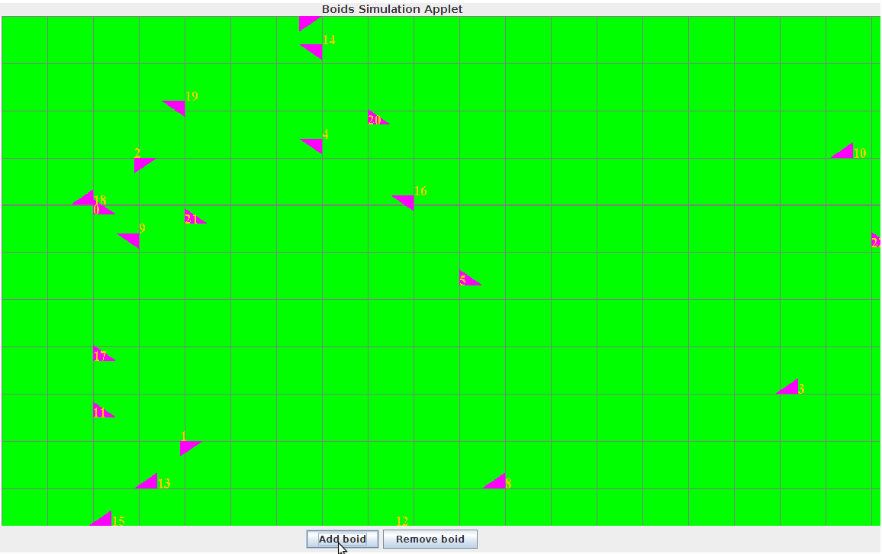
Framework
Example
Boids Example as of 05/23/2013

Slide 5
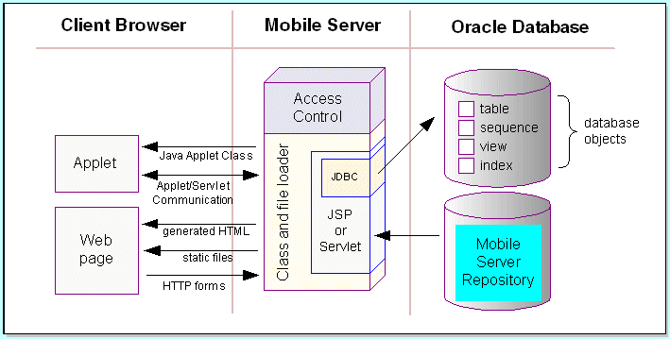
Structure
Applet
Servlet
Shared
http://docs.oracle.com/html/A97671_01/img/dev_arc.gif

Slide 6

Framework Intents
Applet
Be accessed by website
Communicate with server
Provide GUI
http://www.enviromath.com/images/javacup.jpg

Slide 7

Framework Intents
Servlet
Do all of the “hard work”
Communicate with applet
http://content.scholastic.com/content/media/products/67/0439508967_rgb3_xlg.jpg

Slide 8

Framework Intents
Shared
Be accessible by both of the other types
Represent the means of communication
Provide abstractions
http://readwrite.com/files/styles/800_450sc/public/fields/share_0.jpg

Slide 9
Questions?

